Slide 1
AngularJS For beginners
-Santosh Kumar Kar

Slide 2
What is AngularJS
JavaScript MVC framework for the Web
pure JavaScript and HTML
Unit Testable
For Web and Mobile
Less code
Can integrate 3rd party libraries such as jQueryUI/BootStrap

Slide 3
MVC
The model is the driving force of the application. This is generally the data behind the application, usually fetched from the server. Any UI with data that the user sees is derived from the model, or a subset of the model.
The view is the UI that the user sees and interacts with. It is dynamic, and generated based on the current model of the application
The controller is the business logic and presentation layer, which performs actions such as fetching data, and makes decisions such as how to present the model, which parts of it to display, etc.

Slide 4
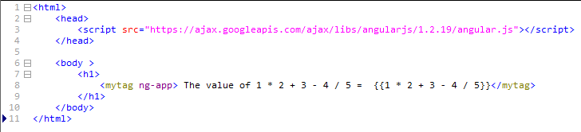
First Application ng-app

Slide 5

Task – 1
Write a Angular Application which prints the value of below expressions:
5 *5 + 2*2
10/5*2-100

Slide 6
AngularJS Directives
Markers on DOM elements (such as elements, attributes, css, and more).
Used to create custom HTML tags that serve as new, custom widgets.
AngularJS has built-in directives (ngBind, ngModel...)

Slide 7
directive ng-app
first and most important directive
Tells the section of HTML that AngularJS controls
Need to put in any tag, preferable at <html> or <body>
Anything outside of the tag would not be processed

Slide 8
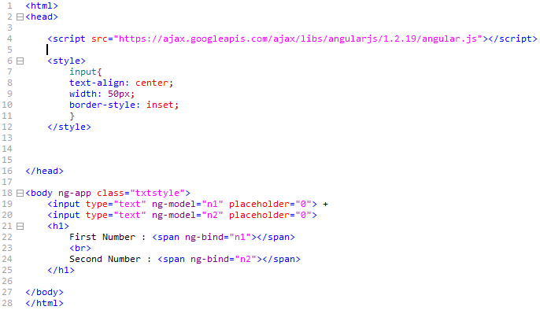
directive ng-model, ng-bind

Slide 9
directive ng-model
used with input fields, user to enter any data and get access to the value in JavaScript.
In ng-model="n1", AngularJS stores the value that the user types into in a variable called "n1"

Slide 10
directive ng-bind
Binds with the Angular JS variable
ng-bind in <span>
<span ng-bind="n1"
is similar to
{{n1}}

Slide 11
Modules
Modules in AngularJS are similar to packages in java
Container for the different parts of your app – controllers, services, filters, directives, etc.
Can define its own controllers, services, factories, and directives which are accessed throughout the module.
Can depend on other modules as dependencies and made available to all the code defined in this module.

Slide 12
Modules
Module name we define
Array of dependent modules
angular.module(‘myApp', []);
Creating a module with no dependencies
angular.module(‘myApp', ['myapp.ui', 'yourapp.diagram']);
Creating a module with 2 other dependent modules
angular.module(‘myApp');
looks an existing module to make it available to use, add, or modify in the current file.

Slide 13
Controller
Fetch data from the server for UI
Are regular JavaScript Objects.
ng-controller directive defines the application controller.

Slide 14
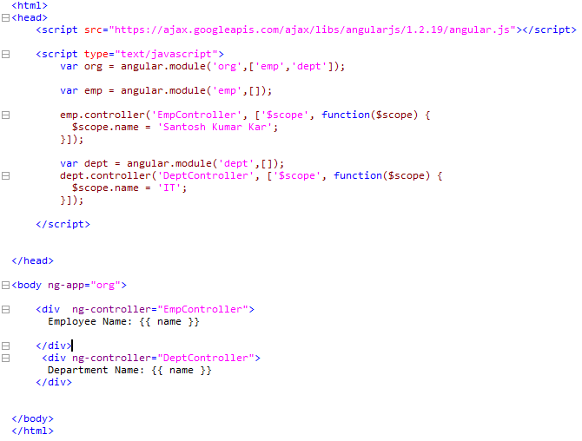
Parent module
Child modules
Defined 2 Controllers
Using parent module only

Slide 15
Task – 2
Write an Angular Application which prints current date and time on the screen

Slide 16
controllerAs
Can be used in AngularJS 1.2 and later
Allows to define the variables on the controller instance using the this keyword instead of $scope
Directly can be referred through the controller from the HTML

Slide 17
controllerAs
$scope.name = 'some value'
changed to
this.name = 'some value';
ng-controller="EmpController"
changed to
ng-controller="EmpController as emp"
{{ name }}
changed to
{{ emp.name }}

Slide 18
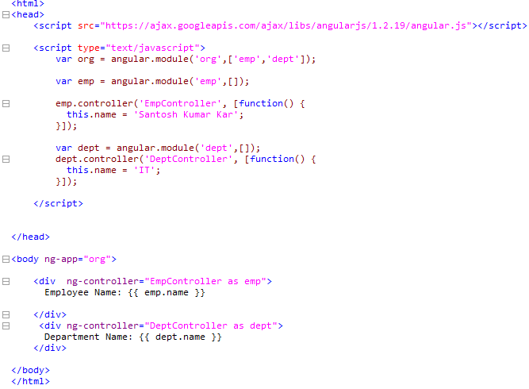

Slide 19
directive ng-repeat
Similar to for each loop
Allows to iterate over an array
Allows to iterate over keys and values of an object
Syntax: ng-repeat="eachVar in arrayVar"

Slide 20
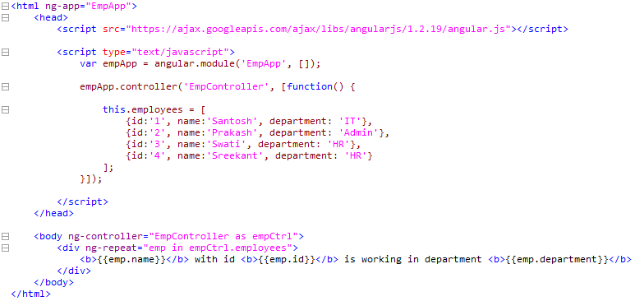

Slide 21
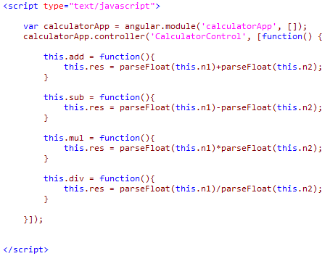
Calculator

Slide 22
Task – 3
Write an Angular Application as
Create a list which stores value of 5 students (id, name, marks) in a school
In HTML, print the name and marks of all the students.

Slide 23
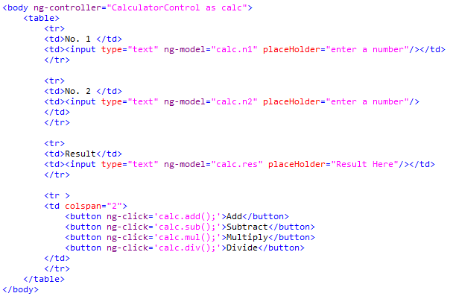
Calculator

Slide 24
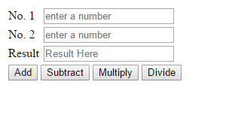
Calculator

Slide 25
Forms
ng-submit
ng-disabled = "myForm.$invalid"
required

Slide 26
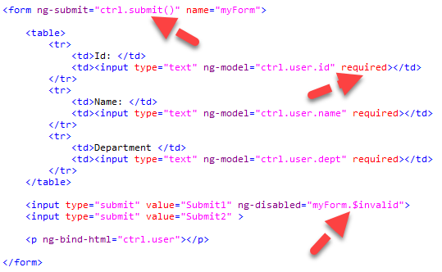
form

Slide 27
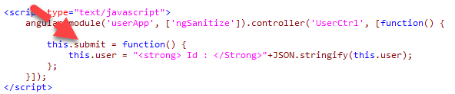
JS

Slide 28
Task – 4
Write an Angular Application
Add few controls with different validation
Add a submit button in the form.
Submit button should be enabled only when all the validations are passed.

Slide 29
Error Handling
Form validation
required
ng-required
ng-minlength
ng-maxlength
ng-pattern
type="email"
type="number"
type="date"
type="url"

Slide 30
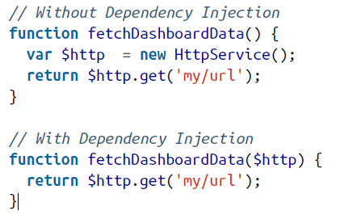
Dependency Injection
Any service known to AngularJS can be injected into any other service, directive, or controller by stating it as a dependency.
AngularJS will automatically create the entire chain before injecting.

Slide 31
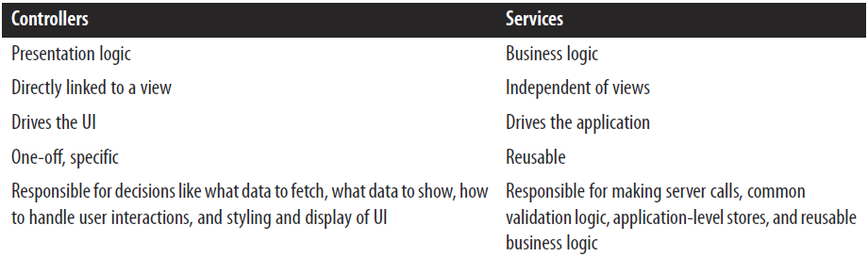
Controller vs Services

Slide 32
Services
Service that is a reusable API or substitutable objects, which can be shared across our applications.
A service in AngularJS can be implemented as a
factory
service
provider

Slide 33
Service types
Build-in
Custom

Slide 34
Common built-In Services
$window
$log
$http
$location
$timeout
$interval
Points to remember:
AngularJS prefixes all the services that are provided by the AngularJS library with the $ sign.
when you create your own services, do not prefix them with a $ sign. It will just end up confusing you and your team at some point in time

Slide 35
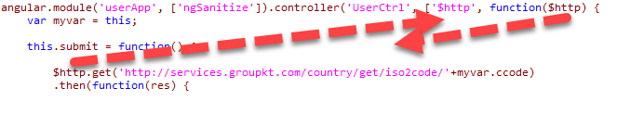

Injecting service
Order of Injection

Slide 36
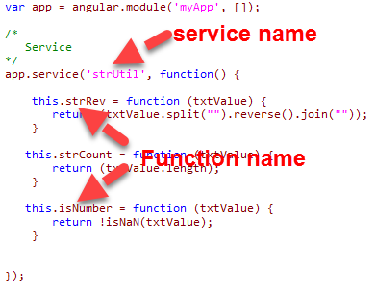
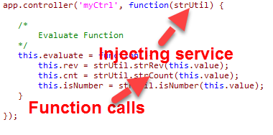
Creating Our Own Service

Slide 37
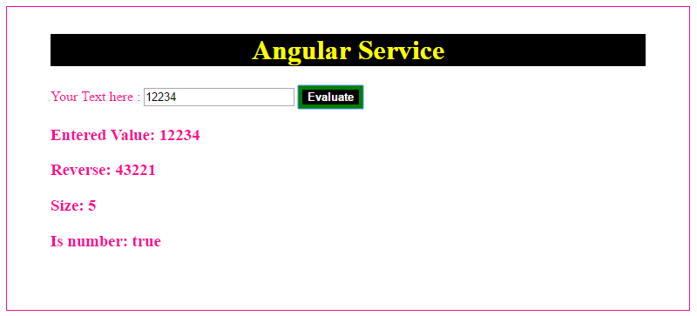
Creating your own service

Slide 38
Data with $http
Similar to request to the server from AJAX applications (using XMLHttpRequests)
Makes request
reads response
checks the error codes
processes the server response
Traditional
var xmlhttp = new XMLHttpRequest();
xmlhttp.open("GET", "http://myserver/api", true);

Slide 39
Task – 5
Write a Angular Application
Add a service, this will take a decimal number as input and print the hexadecimal value of that number.
Few test cases:
Input: 1, output: 1
Input:10, output: A
Input:15, output: F

Slide 40
$http with REST APIs
GET
HEAD
POST
DELETE
PUT
JSONP

Slide 41
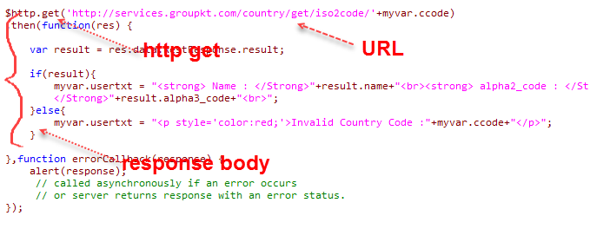
GET request

Slide 42
Task – 6
Write a Angular Application
Which consumes restful web-service with GET, POST, DELETE
(you can write a web-service or see some examples with node.js to create demo restful web-service)

Slide 43

Unit Testing

Slide 44
Filters
Process data and format values to present
Applied on expressions in HTML
Applied directly on data in our controllers and services
Examples:
Format timestamp to readable date string
Add currency symbol on a number

Slide 45
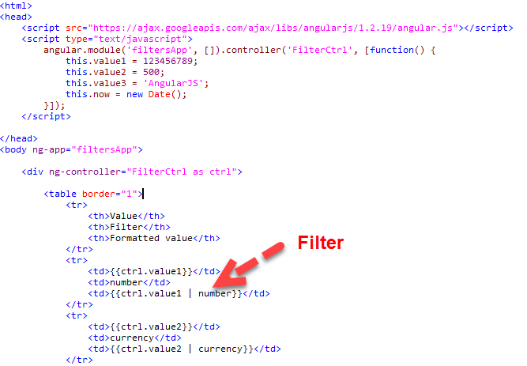

Slide 46
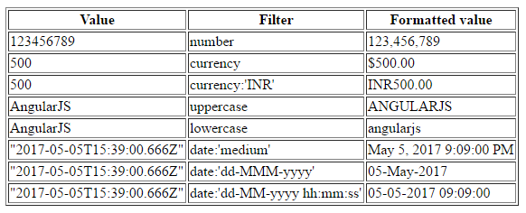
Task – 7
Write a Angular Application
Use in-built filters and produce the below output
(you can write a web-service or see some examples with node.js to create demo restful web-service)

Slide 47
Task – 8
Write a Angular Application and use below built-in filters
orderBy
filter
json
limitTo

Slide 48
Custom Filters

Slide 49
Task – 8
Write a custom filter which accepts a string value and prints every alternate character in lower case preceding to a upper case character.
Test cases:
Input: AngularJS output:AnGuLaRjS

Slide 50
Filters in controllers

Slide 51
Routing with URL - myurl.html#/home
You need Routing if
we call hashbang URLs, not the standard URL
You are developing a single page application
You have multiple views for a single page (e.g. Home Page, About Us, Contact Us etc.)
For each request in a single page, you need to load one of the view as presentation logic but you don’t want to refresh the page.
You don’t need to load the whole page but only the contents of the view
You need speed response by loading contents faster

Slide 52
Routing: how to code
Import angular.js and angular-route.js
Use dependancy model to ngRoute
var myvar = angular.module('org',['ngRoute']);
Config the route provider
$routeProvider.when(url, {
template: string,
templateUrl: string,
controller: string, function or array,
controllerAs: string,
resolve: object<key, function>
});

Slide 53
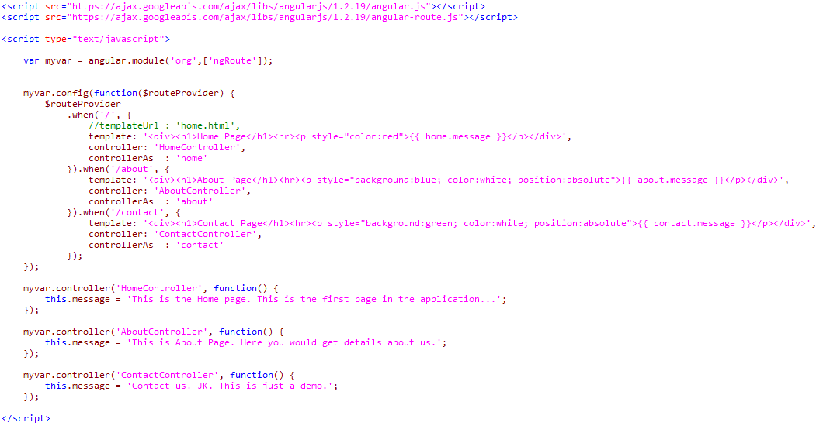

Slide 54

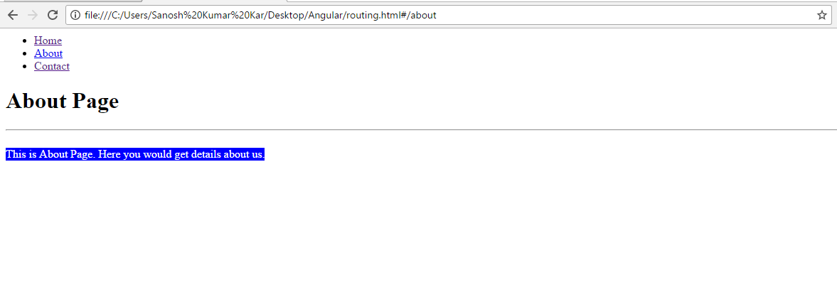
Request in routing : ‘#’ factor
Request in a common URLs:
# in URLs

Slide 55
Task – 9
Make 3 Angular applications (3 views)
Home.html
About.html
Contact.html
In index.html, you need to define 3 links for home, about and contact. On clicking the links it needs to route to respective views without reloading the page.
(Note: You may need to deploy as an application in a server to make it work.)

Slide 56
Things to do:
I didn’t cover the unit testing parts in AngularJS along with mocking up in this presentation for each of the components. I request you to go through the steps for unit testing in internet. If I get time I would add unit testing in a separate presentation. Thank you.

Slide 57


Slide 58
Source Code at:
https://github.com/santoshkar/Angular.git

Slide 59


